Slide 1
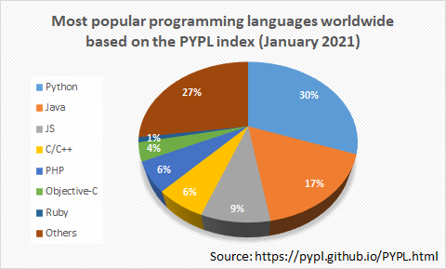
Introduction Abraham Chen
Python Experience
HTML/CSS, Scratch
C++, C#, JavaScript

Slide 2

Students
 | Experience
Justin Chen
Lydia Yang
David Chen
Deron Chen
Raymond Chen

Slide 3
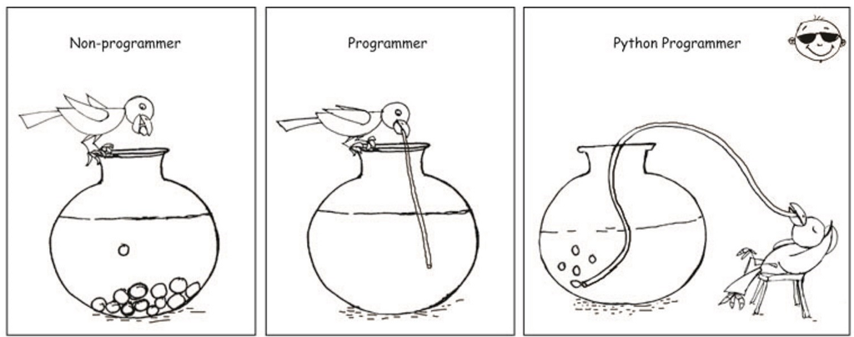
WHAT IS Python?
General-purpose language
High-Level language
Simple and powerful language
Notes:
a crow drinks water
Non-programmers will use rocks to make the water rise
The programmer uses a straight straw to drink water
Python programmers can lie on a chair and blow bubbles

Slide 4

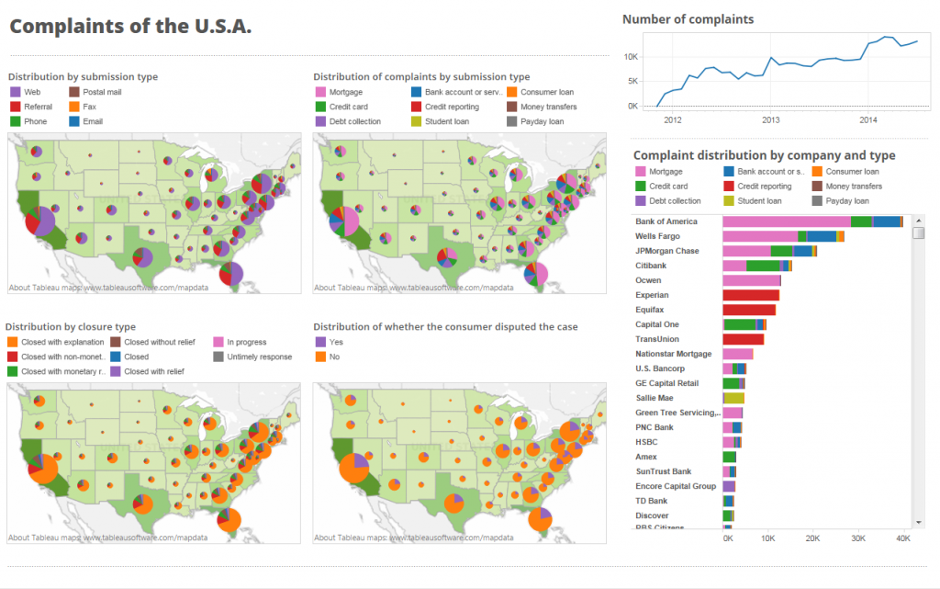
Data Analysis
Notes:
Through python you can easily analyze the data and form a graph like this

Slide 5
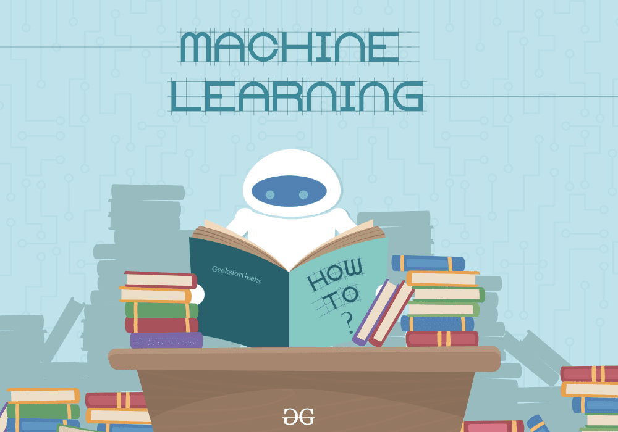
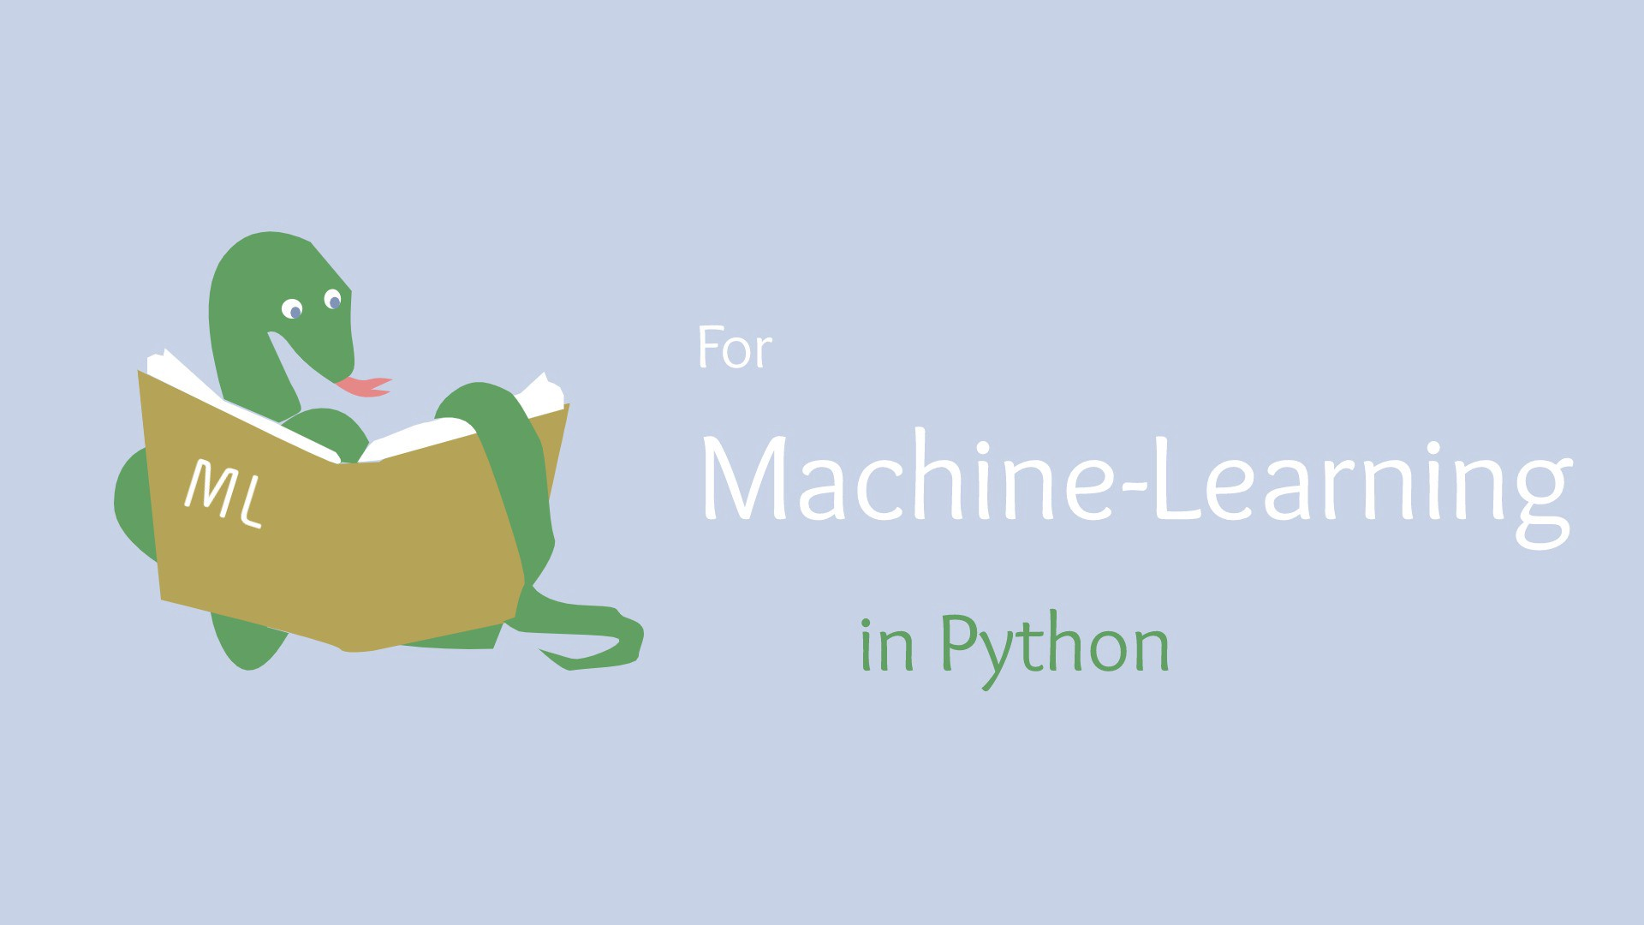
Machine Learning
Notes:
You can write Python programs to guide the robot to learn on its own
Python is a learning snake, When it gets into the robot, the robot can also learn by itself

Slide 6
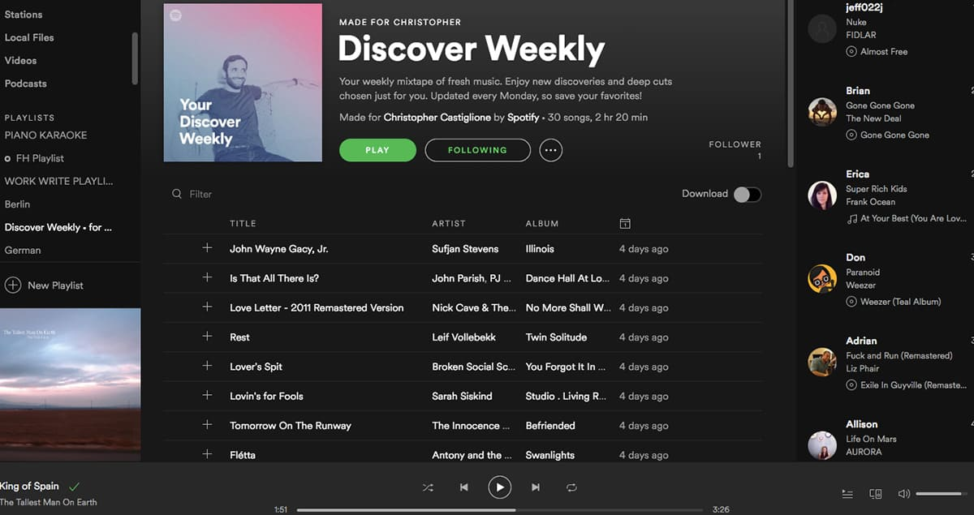
Website
Notes:
Python has built many famous website programs: spotify
https://open.spotify.com/?utm_campaign=redirect.webplayerlink&utm_content=77703c9c7729e45a9fd47f58245ae22d&utm_medium=www_footer&utm_source=www.spotify.com

Slide 7
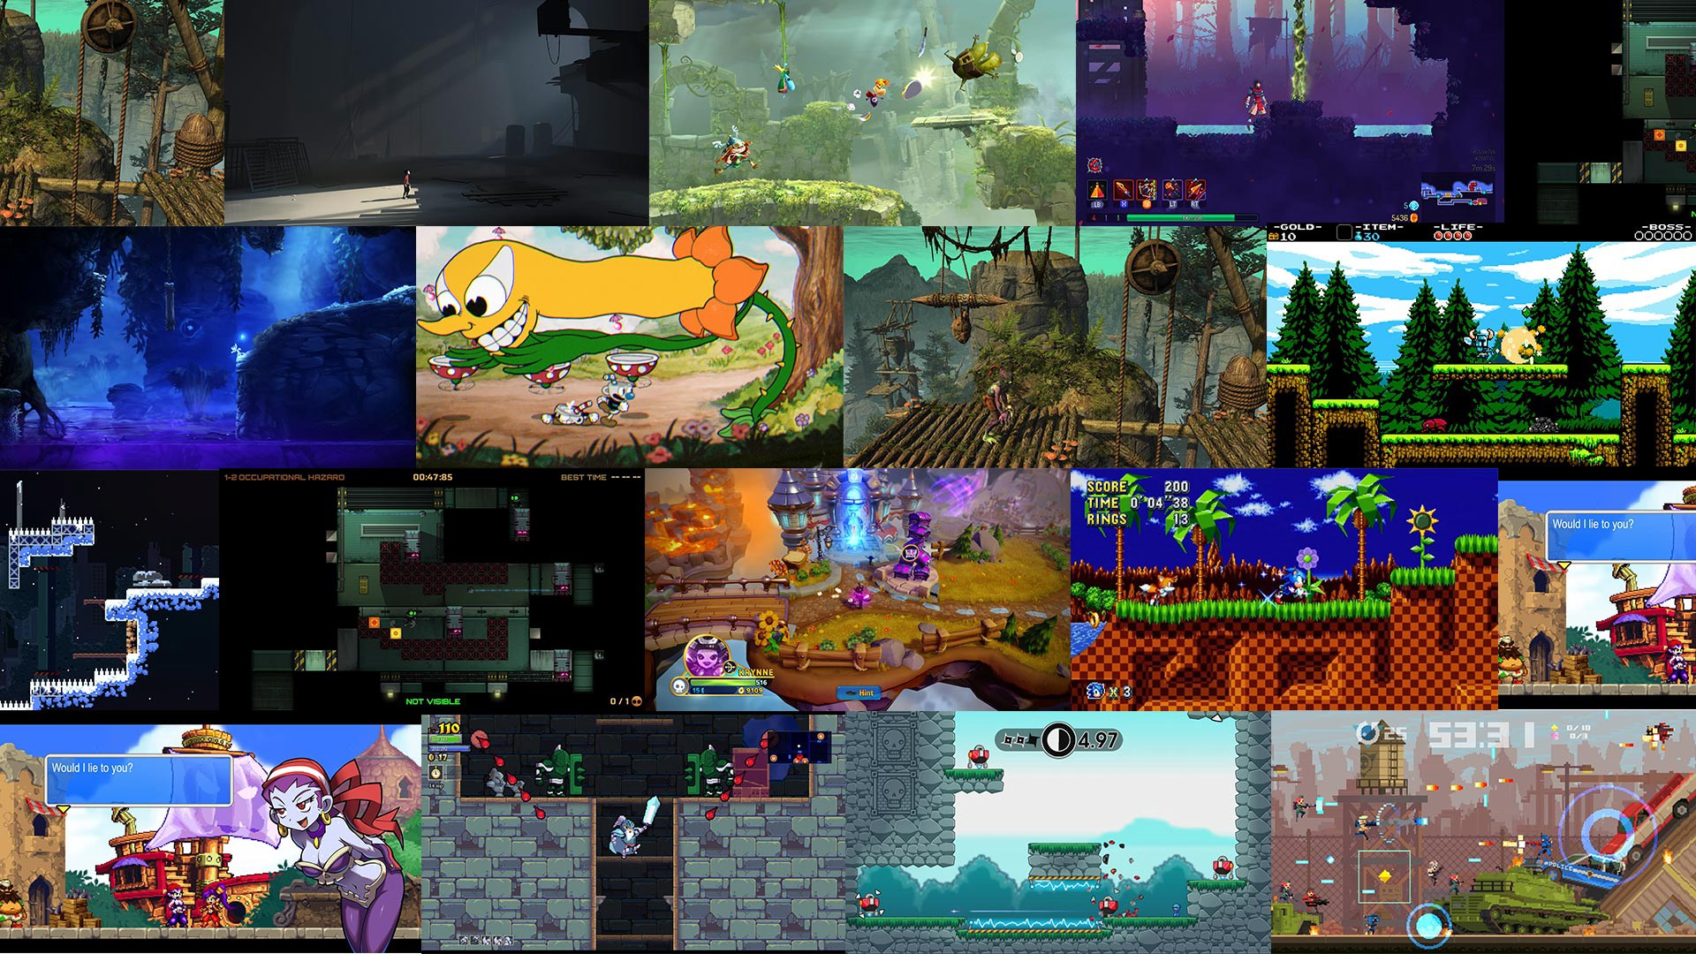
Game
Notes:
Python can build Games as well
Show one python game to the student

Slide 8
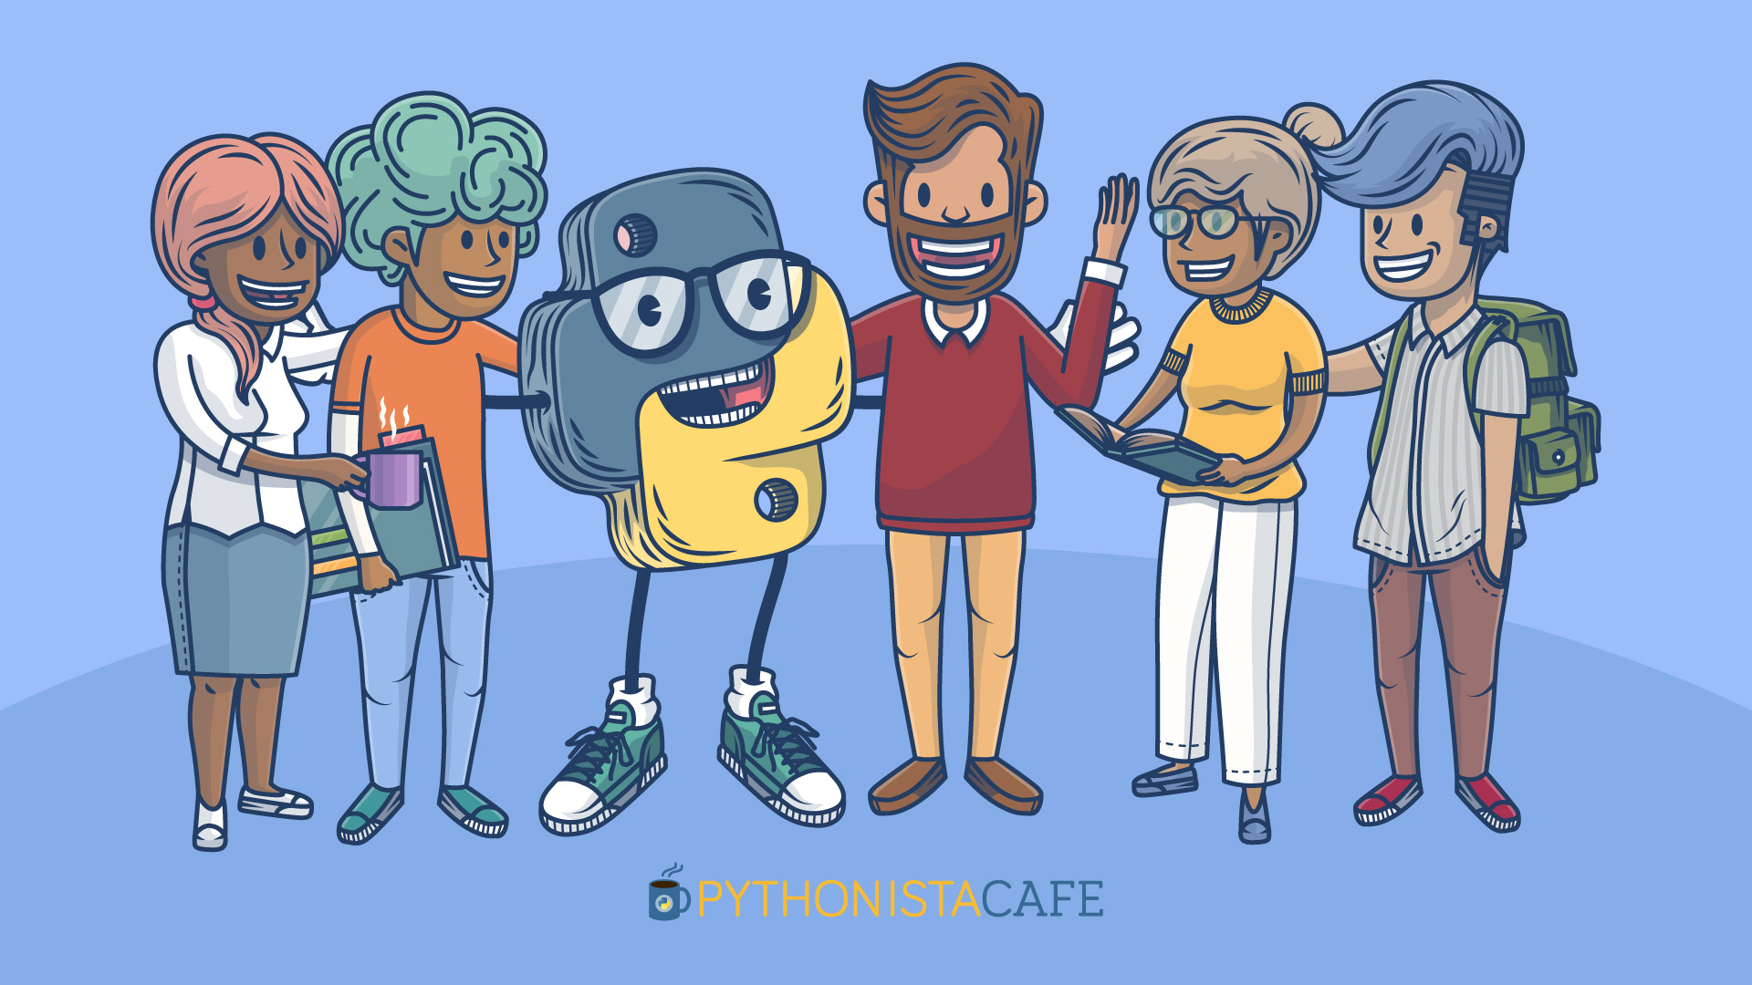
Community and Library
Notes:
Python has a very strong communication community and shared libraries
You can collaborate with engineers all over the world to complete many open-source projects
Python is an open-sourced language, and in recent years has increased in popularity due to its use in data science.
Python also has a strong community around machine learning, data modeling, data analysis and artificial intelligence (AI), with extensive resources and libraries built for these purposes.

Slide 9
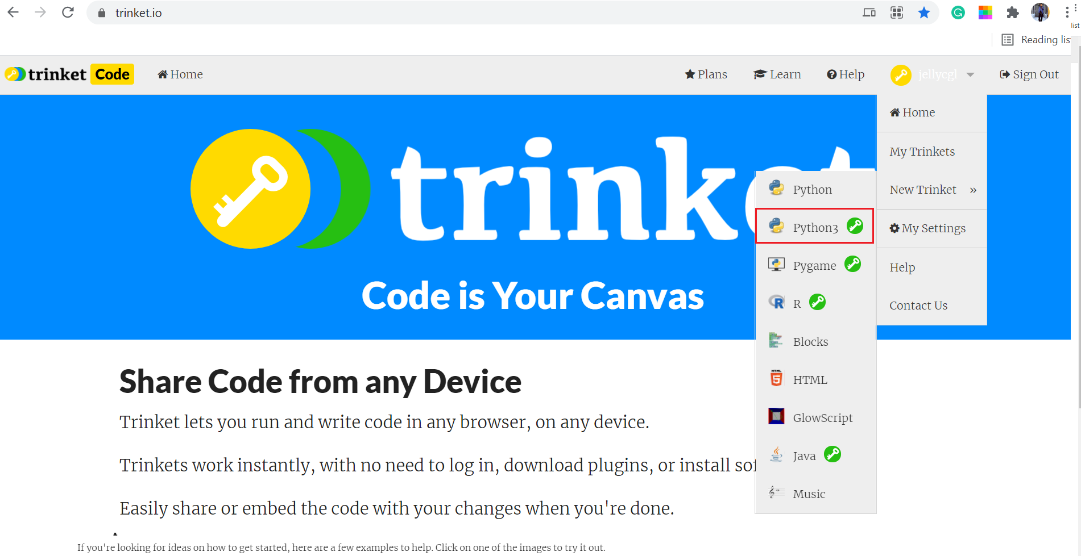
Trinket
Website: https://trinket.io/
Account registration
Create the Python3 project
Basic Use
Begin the first Python project
Hello Python

Slide 10
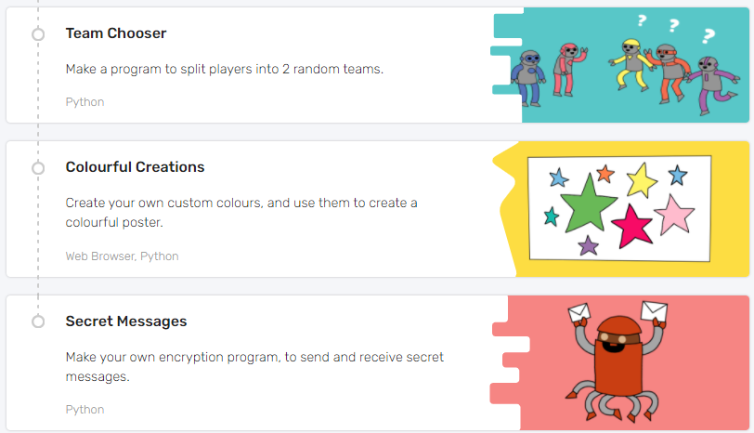
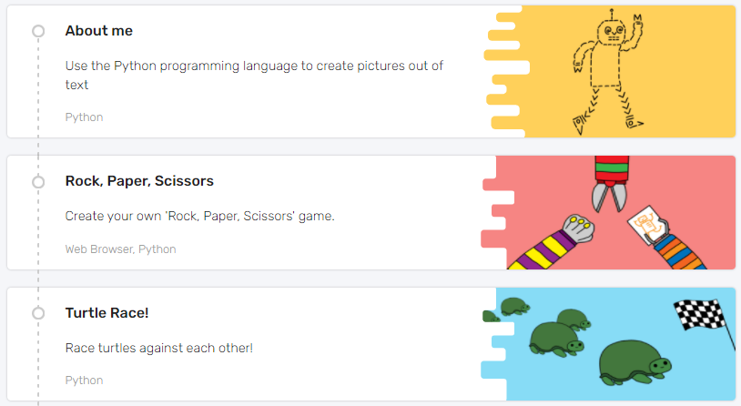
Projects

